Slide 1


Securing the Critical infrastructure
Mazhar Hamayun | Security Evangelist
February 06, 2024
https://www.linkedin.com/in/mazhar-hamayun/

Slide 2
Agenda
Introduction
Core Sectors of Critical Infrastructure
Current State of Critical Infrastructure Protection:
Attack Vector around Critical Infrastructure Systems
Top 10 cyber-attacks on critical infrastructure
Best Practices for Improving Critical Infrastructure Security:

Slide 3
Introduction
Critical infrastructure is the backbone of modern society and economy. These infrastructures provide essential services to the public and support economic growth and development

Slide 4
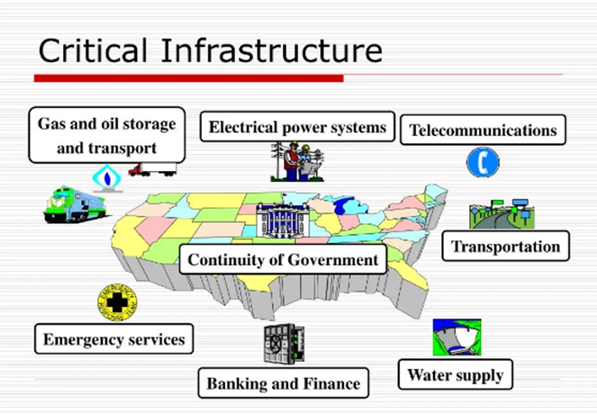

Slide 5
Core Sectors of Critical Infrastructure
The Department of Homeland Security (DHS) is responsible for protecting critical infrastructure from various threats.
The DHS has identified 16 sectors as critical infrastructure

Slide 6
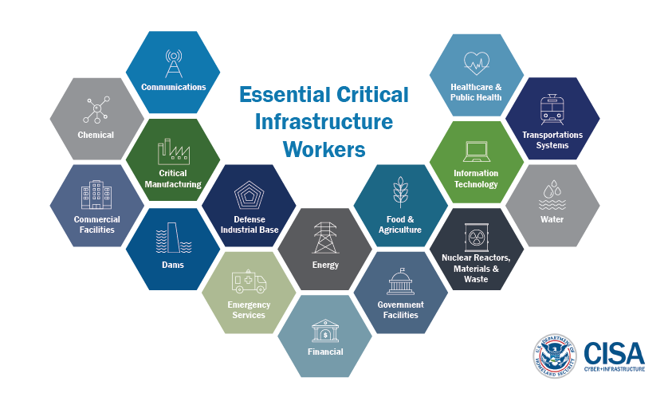
Core Sectors of Critical Infrastructure

Slide 7
Challenges in Critical Infrastructure Protection

Slide 8
Current State of Critical Infrastructure
Increasing complexity
Highly targeted
Emerging threats
Limited resources
Regulatory challenges

Slide 9
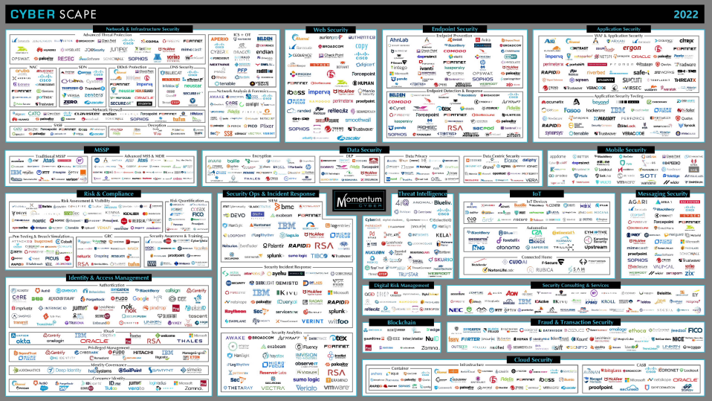

Slide 10
Current State of Critical Infrastructure
Increasing complexity
Highly targeted

Slide 11
Today’s Threats are Sophisticated Threats
EOY 2022
28% increase in Global attacks
18% increase in Education institutions targets
5% increase in ransomware attacks against Healthcare
66% of supply chain attacks leverage unknown vulnerabilities
16% leverage known software flaws
ATTACKS
VULNERABILITIES
Large scale (across country and industry)
Ransomware, Phishing, Social Engineering, BEC
Multi-vector (network, endpoint, mobile, IOT/OT, cloud)
IOT/OT attacks, Zero-Day exploits, mobile malware
Commercial & Government Grade Attack tools
Supply chain attacks, weak controls, nation-state threats

Slide 12
Current State of Critical Infrastructure
Increasing complexity
Highly targeted
Emerging threats

Slide 13
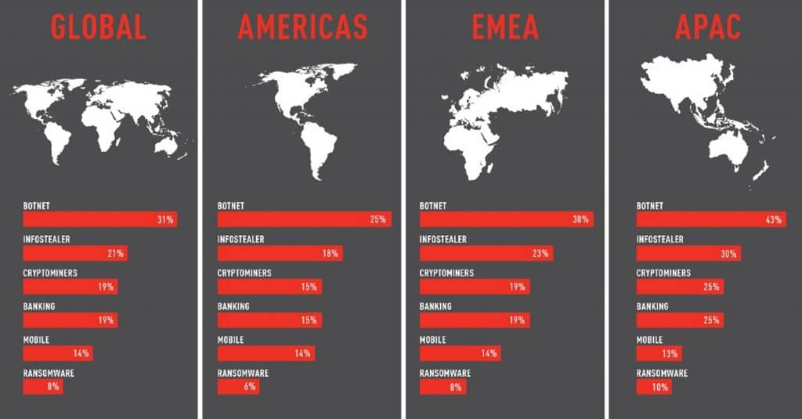
Today’s Threats are Sophisticated Threats
EOY 2022
28% increase in Global attacks
18% increase in Education institutions targets
5% increase in ransomware attacks against Healthcare
66% of supply chain attacks leverage unknown vulnerabilities
16% leverage known software flaws
ATTACKS
VULNERABILITIES
Large scale (across country and industry)
Ransomware, Phishing, Social Engineering, BEC
Multi-vector (network, endpoint, mobile, IOT/OT, cloud)
IOT/OT attacks, Zero-Day exploits, mobile malware
Commercial & Government Grade Attack tools
Supply chain attacks, weak controls, nation-state threats

Slide 14
Current State of Critical Infrastructure
Increasing complexity
Highly targeted
Emerging threats
Limited resources
Regulatory challenges

Slide 15
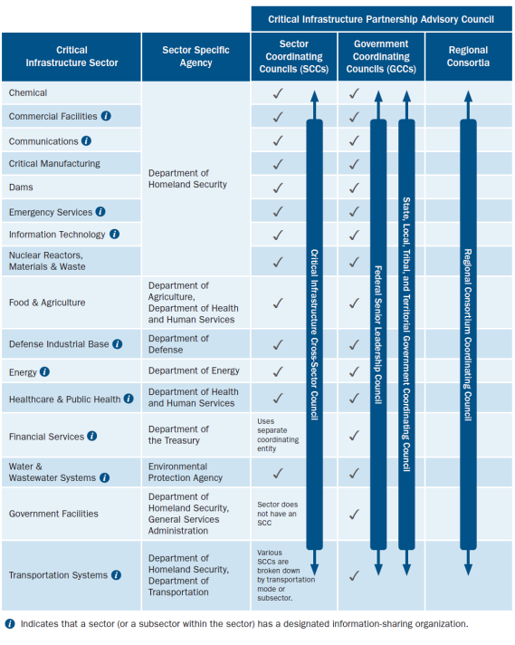
Source: NIPP 2013, "Sector and Cross-Sector Coordinating Structures," at https://www.dhs.gov/sites/default/files/publications/national-infrastructure-protection-plan-2013-508.pdf.

Slide 16
Attack Vector Around Critical Infrastructure

Slide 17
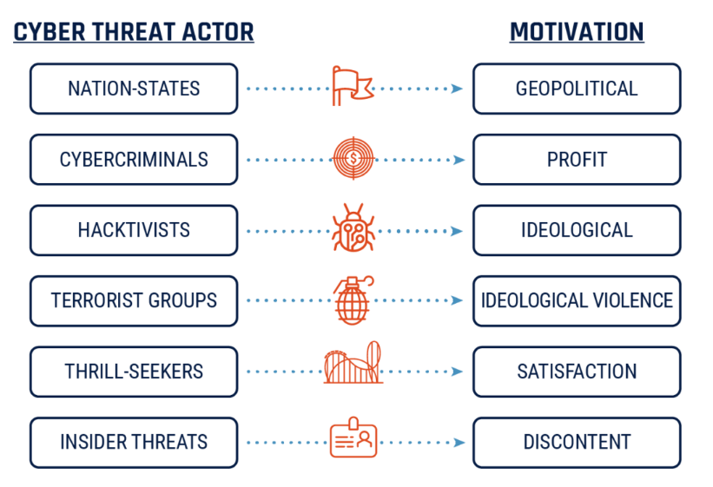
Source :ised-isde.canada.ca

Slide 18
Top 10 cyber-attacks on critical infrastructure

Slide 19

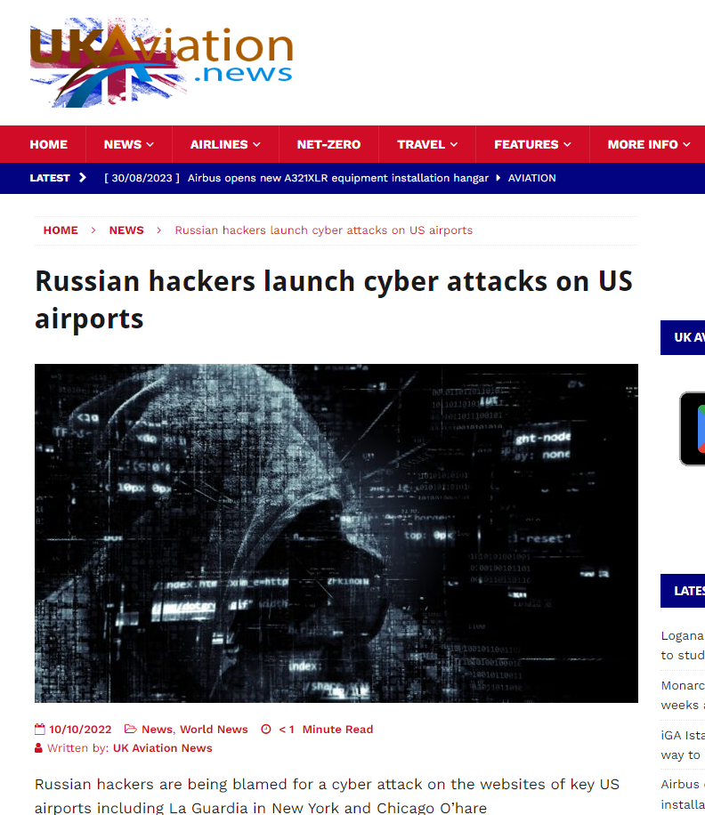
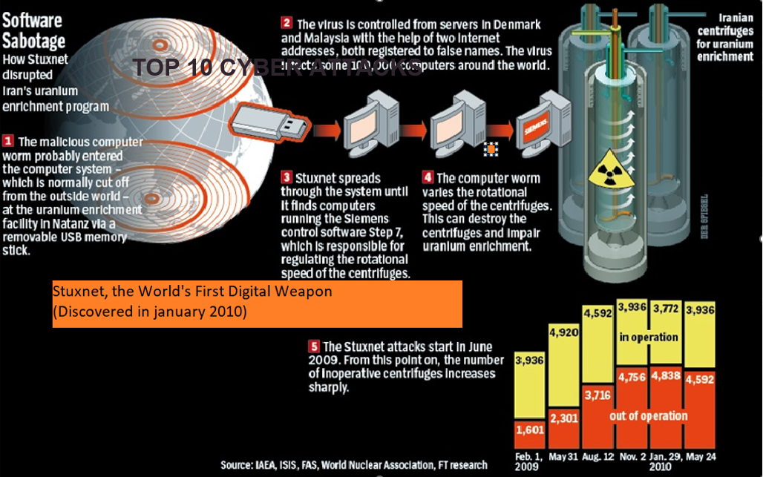
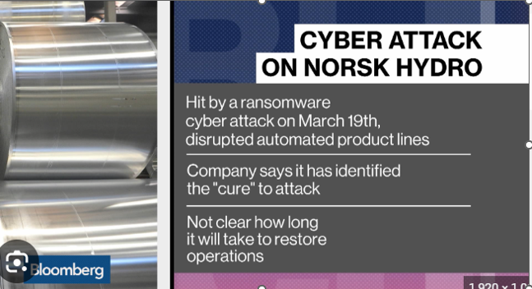
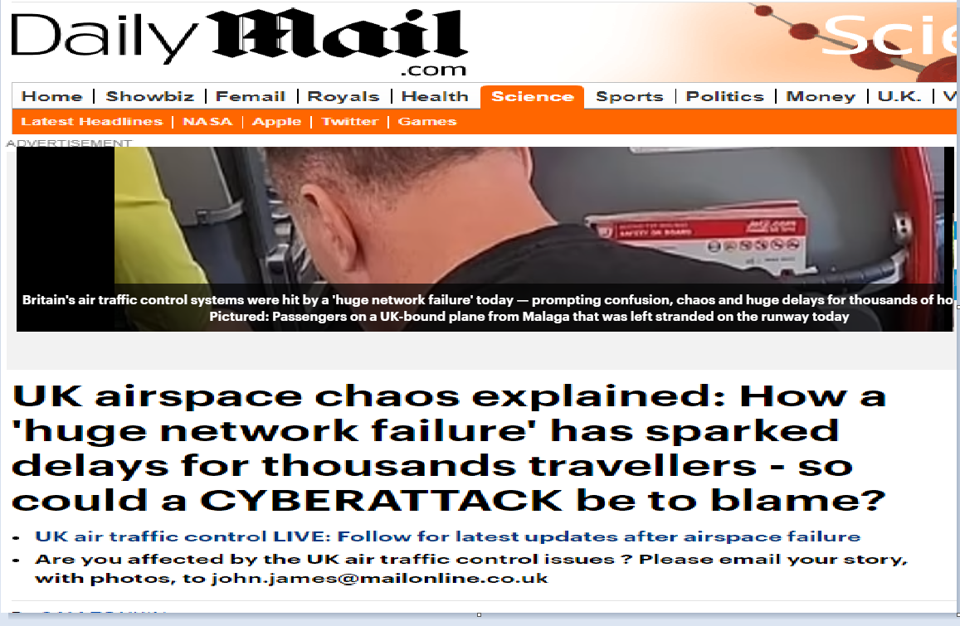
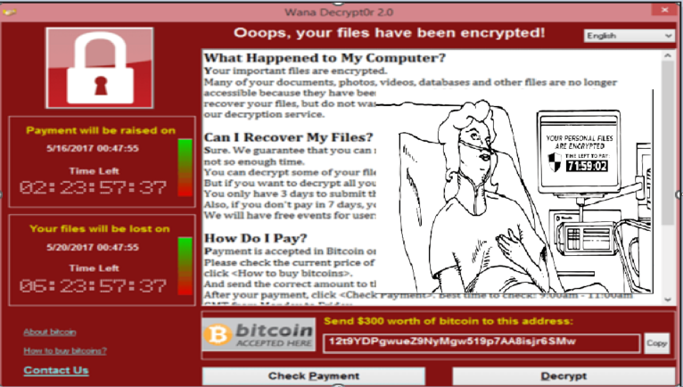
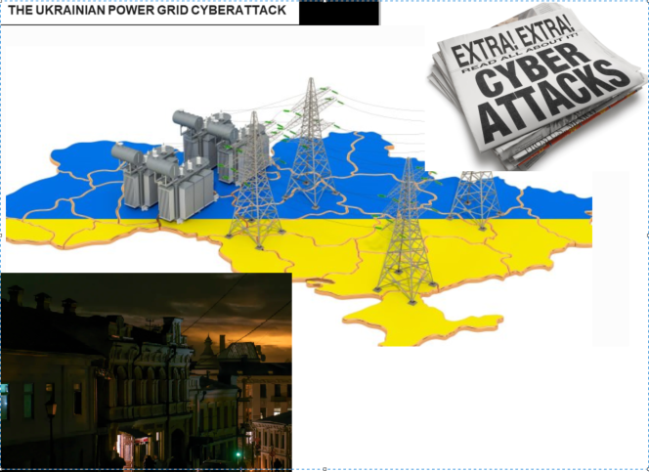
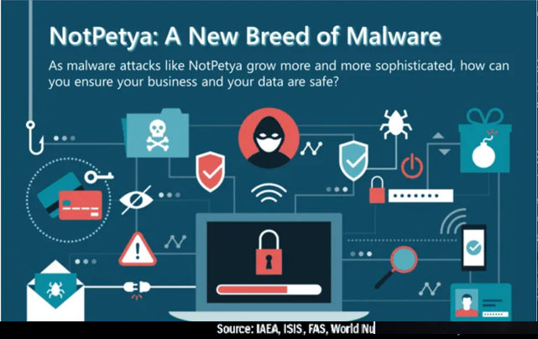
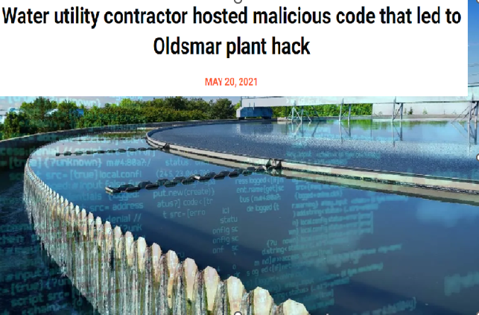
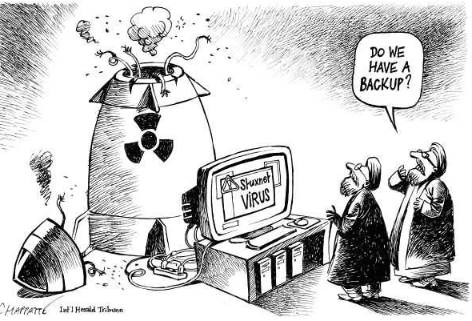
Healthcarefinancenews.com
MAR 29, 2016
The virus affected Washington's Georgetown University Hospital and other medical offices in the region. MedStar said in a statement that the virus prevented some employees from logging into the system but that all of its clinics remain open and functioning.
Bloomberg
June 02 2021
Hackers Breached Colonial Pipeline Using Compromised Password
Investigators suspect hackers got password from dark web leak
Colonial CEO hopes U.S. goes after criminal hackers abroad
The Washington Post
February 9, 2021 at 5:36 a.m. EST
A hacker broke into a Florida town’s water supply and tried to poison it with lye, police said

Slide 20
Best Practices for Improving Critical Infrastructure Security

Slide 21
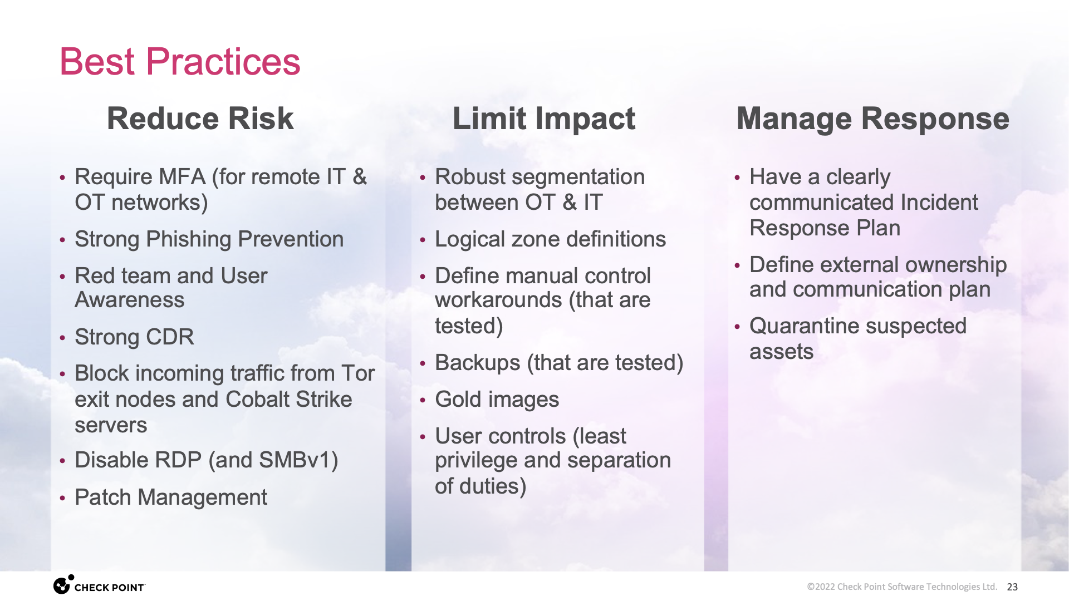
Best Practices

Slide 22
Additional Protections
Protection from known threats
Physical separation of sensitive information
Limit unnecessary lateral communications
Harden network devices
IOC feeds from cisa
Harden operating system
Use secure DNS service

Slide 23
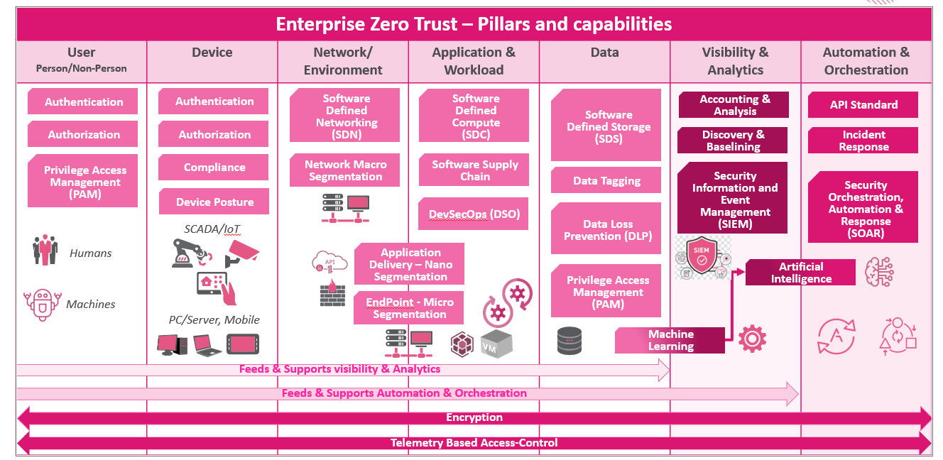
Zero Trust Pillars

Slide 24


Phase 1: Traditional or Implicit Trust
- Static Identity Policies,
- Identity, Networking, Infrastructure are silos.
-Only Macrosegments in place.
- Friction between Business Units due to the lack of integration.
Phase 2: Advanced or Contextual Trust:
-Context Aware security policies in place.
-Business areas & Information Security are integrated.
-Data Classification in place and implemented.
- Macro segmentation & Micro segmentation implemented for critical systems.
Phase 3: Optimal or
Explicit Trust
-Least-Privilege Principle in place
-Business-Driven Policies with CNAPP
-Dynamic Access-Control according with the Risk and Security Posture.
-API-Driven Policies being Agile
-Macro, Micro and Nano segmentation in place for Hybrid Cloud and Applications
-Strong CI/CD Security for Software Supply Chain.
Zero-Trust Architecture Maturity Phases
Transformation Process
Implicit Trust
Explicit Trust

Slide 25
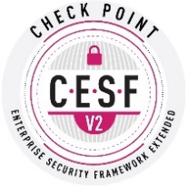
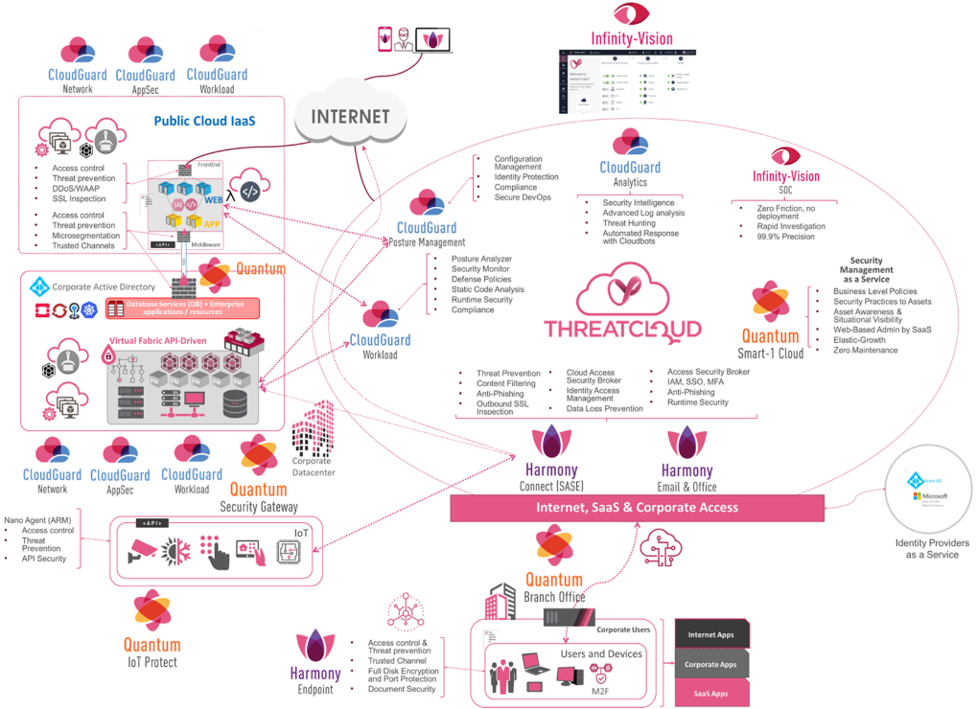
Zero Trust Target Architecture
A unique set of tools and case-specific recommendations
High-level Architectural design
Controls and products alignment
Segmentation design
Detailed Functional Controls description and explanation

Slide 26
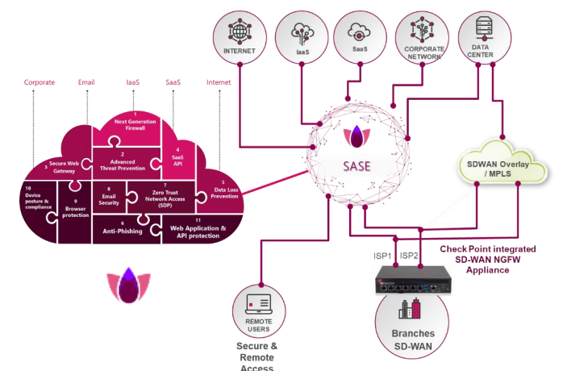

Slide 27

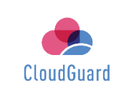



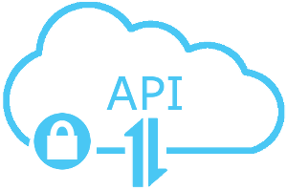




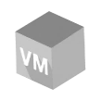
Logical Connectivity for ZT (example)
Posture Management
Network Security
Developer
Remote worker
Branch Office
Cloud
Encryption Key Management, Activity monitoring
Single sign-on, MFA adaptive access, PAM
Endpoint protection, unified endpoint management
CSPM, CWPP, CASB, SWG
NGFW, IPS, URL, AV, DLP
ZTNA
Internet
Hybrid Cloud
SASE / SD-WAN
Code, Image & IAC Scanners, OWASP top 10
ZT network access, NG and Web application firewall
Unified Policy, Consolidated monitoring & reporting
SWG, CASB, DLP, Sandboxing
ZT network access, NG and Web application firewall
Credentials, API keys, PCI, CI/CD
Source code
Published services
SaaS
DC
Security Operations team
Spectral
Gateways

Slide 28
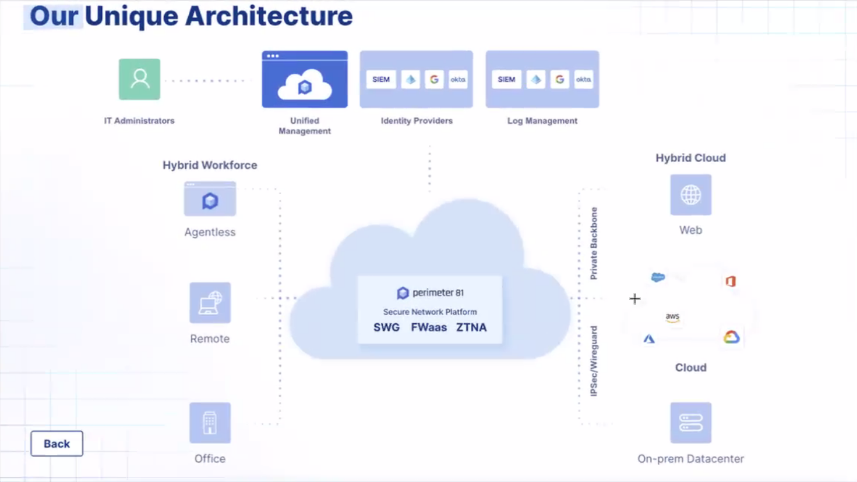

Slide 29
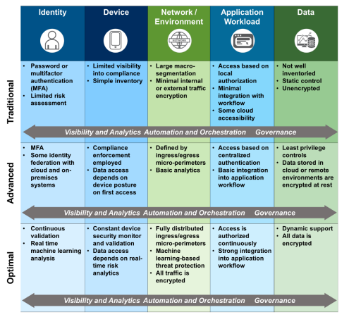
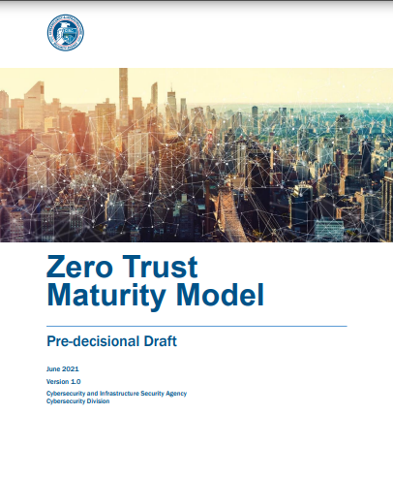
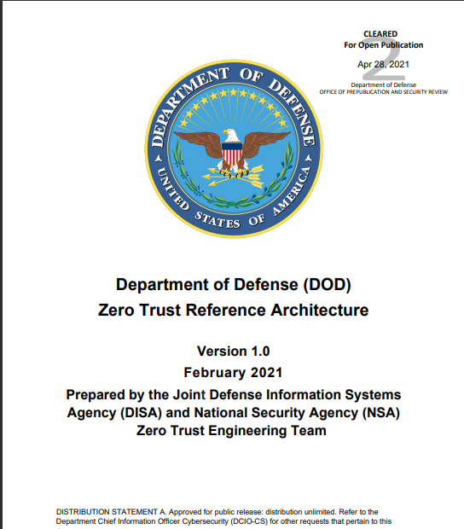
Zero-Trust Maturity Model, Where to Start? - CISA

Slide 30
Important Links
National Cyber Security Strategy
Https://Www.Whitehouse.Gov/Wp-content/Uploads/2023/03/National-cybersecurity-strategy-2023.Pdf
Securing Key Infrastructures Across The EU
Https://Www.Enisa.Europa.Eu/Topics/Critical-information-infrastructures-and-services
Cisa Cybersecurity Best Practices
Https://Www.Cisa.Gov/Topics/Cybersecurity-best-practices
Critical Infrastructure Security And Resilience
Https://Www.Cisa.Gov/Topics/Critical-infrastructure-security-and-resilience
Zero Trust Maturity Model
Https://Www.Cisa.Gov/Zero-trust-maturity-model
United Nations Resolution 2341 (2017)
https://press.un.org/en/2017/sc12714.doc.htm

Slide 31
Thank you!

